Slide 1
Public School Ranking System

Slide 2




Kyla Joyce M. Julian
SS152
PROJECT MANAGER
Rhea-Eve M. Ayungon
SS152
DEVELOPER / QUALITY ASSURANCE ANALYST
Kathrine Danielle C. Burton
SS152
DATABASE ANALYST / DOCUMENTATION LEAD
Joneil Thom O. Llantos
SS152
LEAD DEVELOPER

Slide 3






WHAT IS IT ABOUT?
Notes:
can help schools be aware and help improve their students’ performance in their major subjects namely: Filipino, English, Mathematics, Science, and Araling Panlipunan through the help of Analytics.

Slide 4

OUR CLIENT

Slide 5




DepEd: Bureau of Educational Assessment
Regional Directors
Division Superintendent
Student
Notes:
The project will be useful for the Bureau of Educational Assessment and will be beneficial to the Regional Directors, Division Superintendents down to the students.

Slide 6

PROBLEM STATEMENT
Aside from the fact that the system is not yet implemented in the country, it is also evident that quality education in public schools is compromised and needs improvement in technology.

Slide 7

SITUATIONAL ANALYSIS
Aside from the fact that the system is not yet implemented in the country, it is also evident that quality education in public schools is compromised and needs improvement in technology.

Slide 8

PROPOSED SOLUTION
Design a software which will be useful to evaluate student performance on OMR sheets.
Build an exam generation system that is powered by Moodle
Build a ranking system on a dashboard that can produce reports.
Notes:
The system will be designed to process, extract and evaluate the scanned answer sheets.
to build and facilitate exams with a variety of questions and answers.
This will help in tracking the school’s down to its student’s performance.

Slide 9

The expected outome

Slide 10

Improved access and data availability to academic performance.
Improved exam assessment.
Reduced errors in administering un-centralized exams.
Improved accuracy and reliability of exam results.
Reduced time to prepare reports

Slide 11

DIAGRAMS

Slide 12
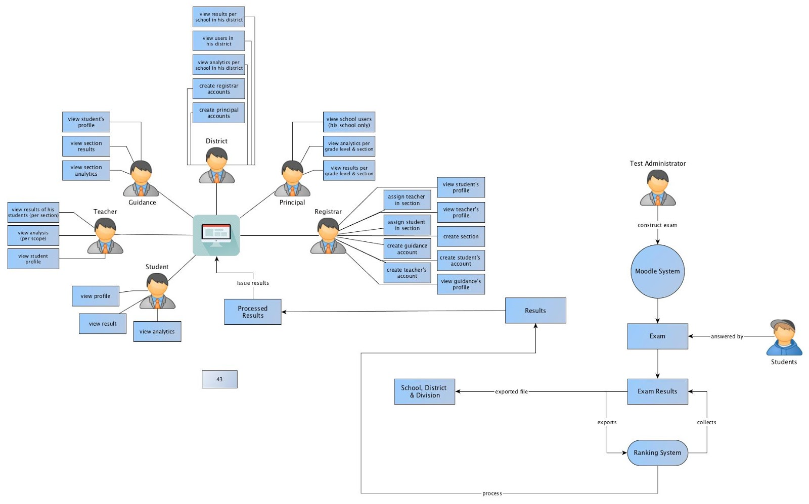
Context level diagram (Moodle)

Slide 13
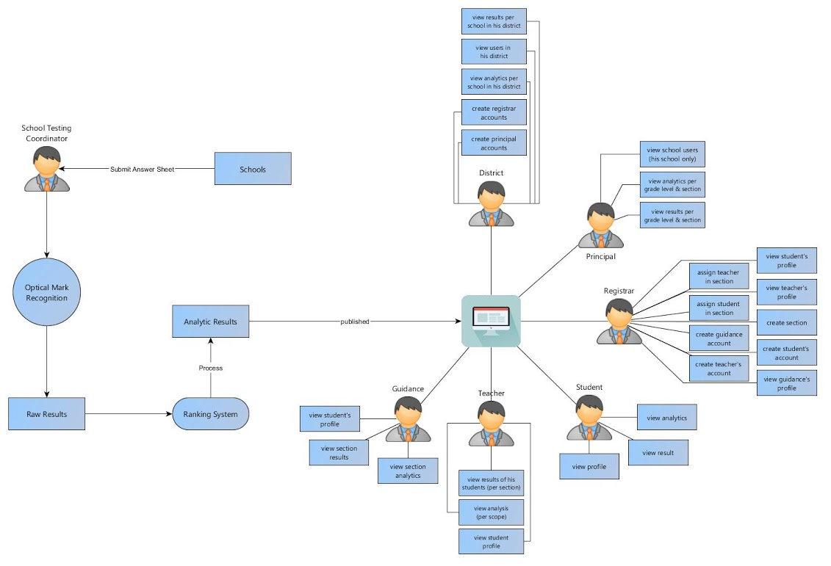
Context level diagram (OMR)

Slide 14
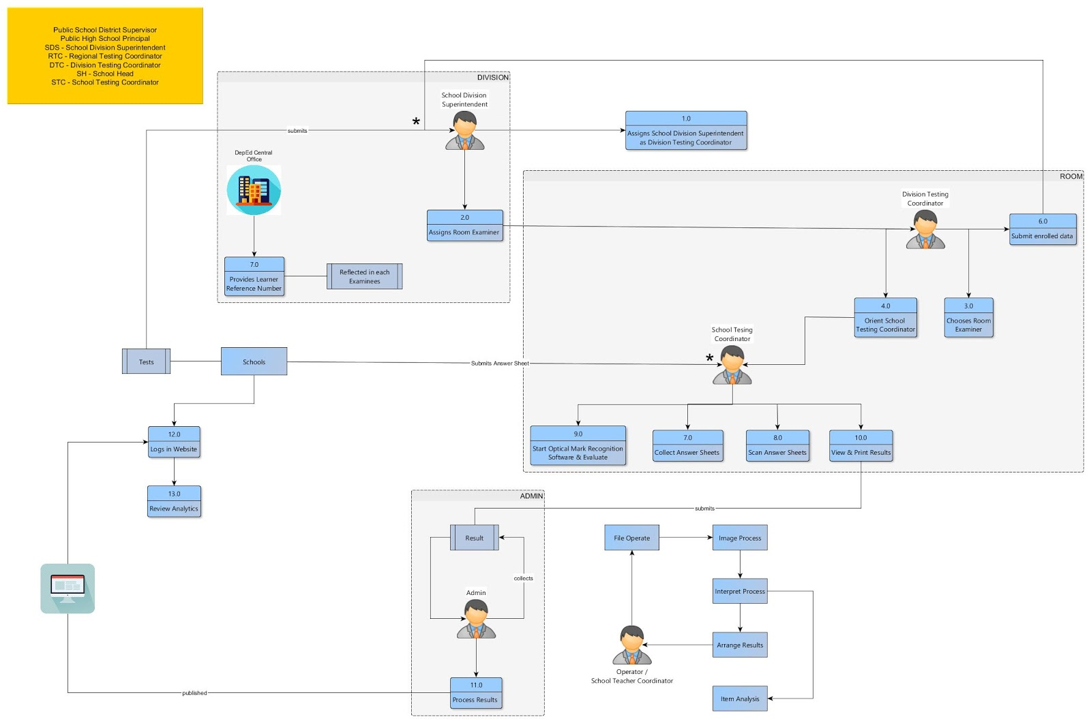
Data flow diagram

Slide 15
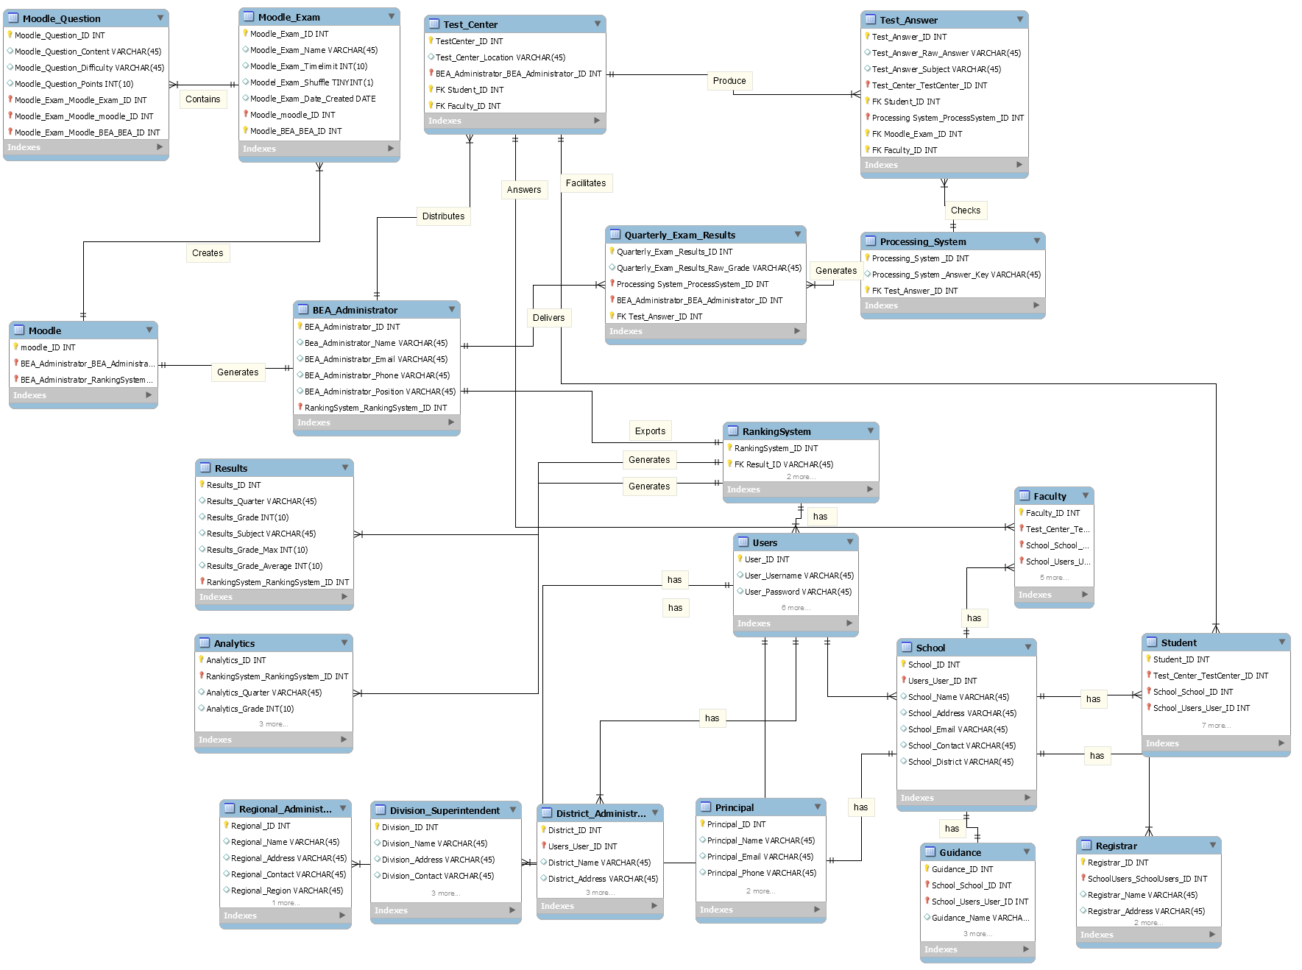
ERD (Moodle)

Slide 16
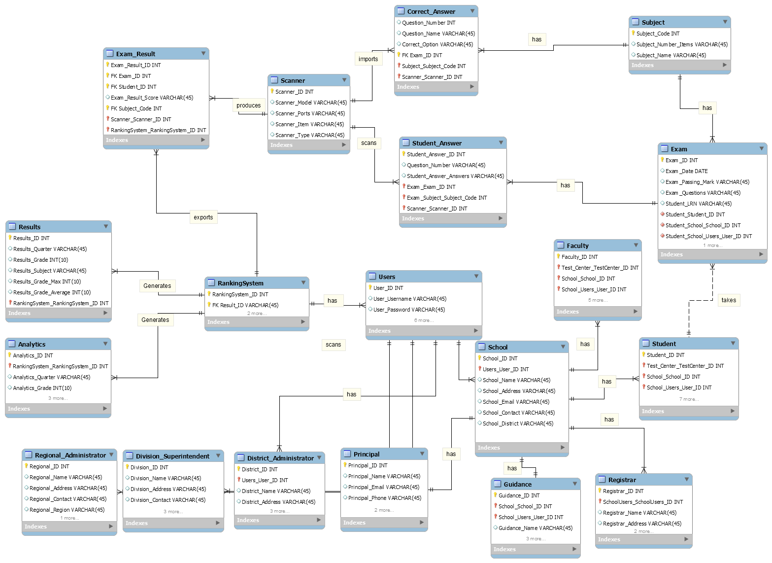
ERD (omr)

